Slide 1

Statistical Computation Methods for Data Science
Unit-I
Lecture - 6
S U RAVI KUMAR CHAVALI
Assistant Professor
Department of Science and Humanities
SNIST

Slide 2
We discuss the following in today’s Lecture
Measures of Dispersion
Range
Mean Deviation
Standard Deviation

Slide 3
Measures of Dispersion
Averages or the measures of central tendency give us an idea of tile concentration of the observations about' the central part of the distribution.
If we know the average alone we cannot form a complete idea about the distribution.
For example:
Consider the series (i) 7, 8, 10, 11, 9 (ii) 3, 6, 9, 12, 15, (iii) 1, 5, 9, 13, 17.
In all these cases, the number of observations is 5 and the Mean is 9. If we are given that the mean of 5 observations is 9, we cannot form an idea as to whether it is the average of first series or second series or third series or of any other series of 5 observations whose sum is 45. Thus we see that the measures of central tendency are inadequate to give us a complete idea of the distribution. They must be supported and supplemented by some other measures, One such measure is Dispersion.

Slide 4
Dispersion
Literal meaning of dispersion is ‘scatteredness'. We study dispersion to have an idea about the homogeneity or heterogeneity of the distribution.
Characteristics for an Idea on measure of Dispersion:
The idea of measure of dispersion are the same as those for all idea of measure of central tendency,
(i) It should be rigidly defined.
(ii) It should be easy to calculate and easy to understand.
(iii) It should be based on all the observations.
(iv) It should be amenable to further mathematical treatment.
(v) It should be affected as little as possible by fluctuations of sampling.

Slide 5
Dispersion
Dispersion is the extent to which values in a distribution differ from the average of the distribution.
To quantify the extent of the variation, there are certain measures namely:
(i) Range (ii) Quartile Deviation
(iii)Mean Deviation (iv) Standard Deviation

Slide 6
Range
For Ungrouped Data,
This is the simplest possible measure of dispersion and is defined as the difference between the largest and smallest values of the variable.

Slide 7
Note: In individual observations and discrete series, L and S are easily identified.
In continuous series, the following two methods are followed.
Method 1: L = Upper boundary of the highest class
S = Lower boundary of the lowest class.
Method 2: L = Mid value of the highest class.
S = Mid value of the lowest class.

Slide 8
Example 1
The yields (kg per plot) of a cotton variety from five
plots are 8, 9, 8, 10 and 11. Find the range
Solution: L=11, S = 8.
Range = L – S = 11- 8 = 3

Slide 9
Solution:
L = Upper boundary of the highest class = 75
S = Lower boundary of the lowest class = 60
Range = L – S = 75 – 60 = 15
Example 2:
Calculate range from the following distribution
Size | 60-63 | 63-66 | 66-69 | 69-72 | 72-75
Number | 5 | 8 | 42 | 27 | 8

Slide 10

Mean Deviation
For Ungrouped Data,
For n observation x₁, x₂, ……………x_{n} the mean deviation about their mean is given by
$$\overline{x}$$
Mean deviation about their median M is given by

Slide 11
Mean Deviation(For Discrete Data)
Let the given data be
Then, the mean deviation about their mean and median is given by
x: | x₁ | x₂ | - | - | x_{n}
f: | f₁ | f₂ | - | - | f_{n}

Slide 12
Mean Deviation of a continuous frequency distribution (For Grouped Data)
If Class Interval frequency distribution is given then, the mean deviation about their mean and median is given by,
Where x_{i} is the mid value of the class interval.
Note: Where represents the modulus or the absolute value of the deviation , when the -ve sign is ignored.

Slide 13
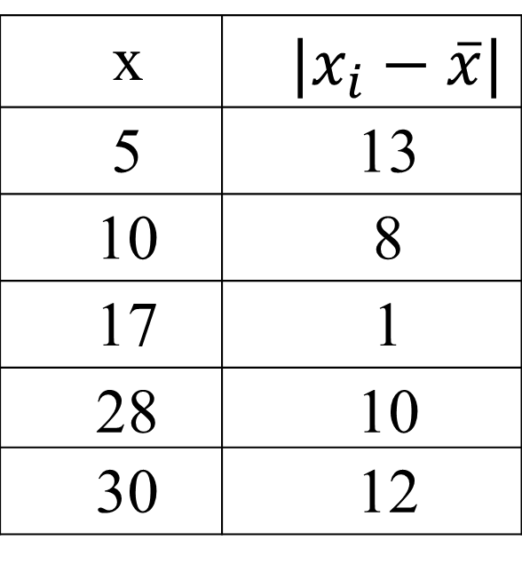
Example 1
From the given data 5,10,17,28,30 find the mean deviation about the mean
Solution:
x | $$|x_{i}−\overline{x}|$$
5 | 13
10 | 8
17 | 1
28 | 10
30 | 12

Slide 14
Example 2
Find the mean deviation about the mean of the following data.
Size(x): | 1 | 3 | 5 | 7 | 9 | 11 | 13 | 15
Frequency(f): | 3 | 3 | 4 | 14 | 7 | 4 | 3 | 4

Slide 15
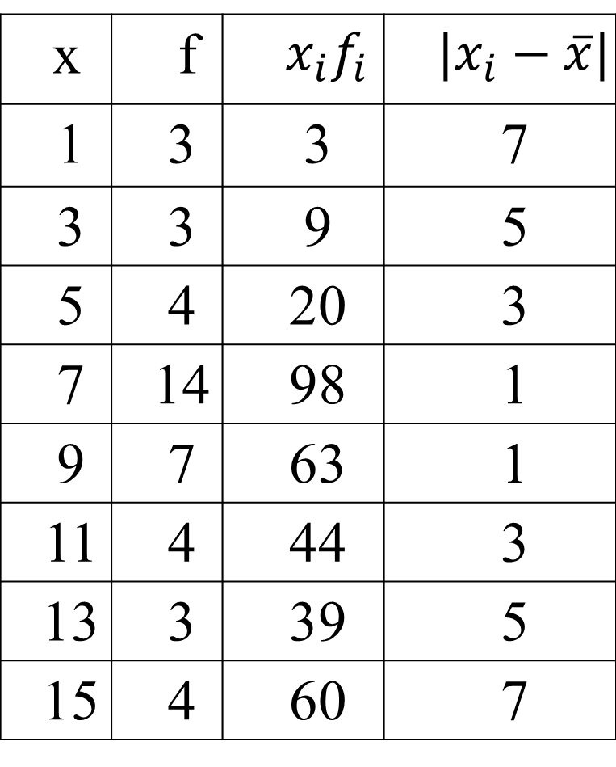
Solution:
x | f | $$x_{i}f_{i}$$ | $$|x_{i}−\overline{x}|$$
1 | 3 | 3 | 7
3 | 3 | 9 | 5
5 | 4 | 20 | 3
7 | 14 | 98 | 1
9 | 7 | 63 | 1
11 | 4 | 44 | 3
13 | 3 | 39 | 5
15 | 4 | 60 | 7

Slide 16
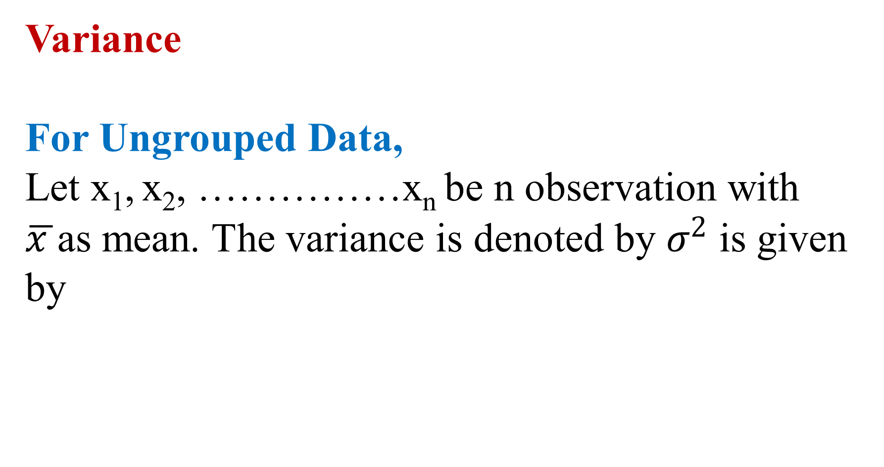
Variance
For Ungrouped Data,
Let x₁, x₂, ……………x_{n} be n observation with $\overline{x }$as mean. The variance is denoted by $σ^{2}$ is given by

Slide 17
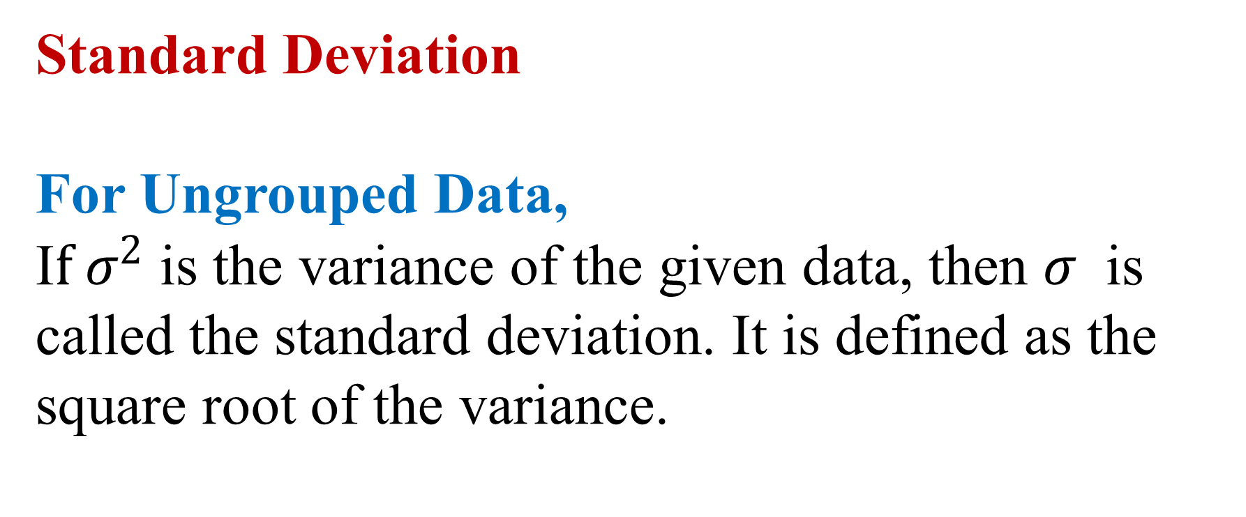
Standard Deviation
For Ungrouped Data,
I$f σ^{2}$ is the variance of the given data, then $σ$ is called the standard deviation. It is defined as the square root of the variance.

Slide 18
Standard Deviation (For Discrete Data)
Let the given data be
Then, the standard deviation is given by
x: | x₁ | x₂ | - | - | x_{n}
f: | f₁ | f₂ | - | - | f_{n}

Slide 19
Standard Deviation (For Grouped Data)
If Class Interval frequency distribution is given then,
the standard deviation is given by,
Where x_{i} is the mid value of the class interval.

Slide 20
Example 1
Find the variance and standard deviation for the following data: 57, 64, 43, 67, 49, 59, 44, 47, 61, 59
Solution:

Slide 21
Example 2
Calculate variance of the following data :
Class interval | Frequency(f):
4-8 | 3
8-12 | 6
12-16 | 4
16-20 | 7

Slide 22
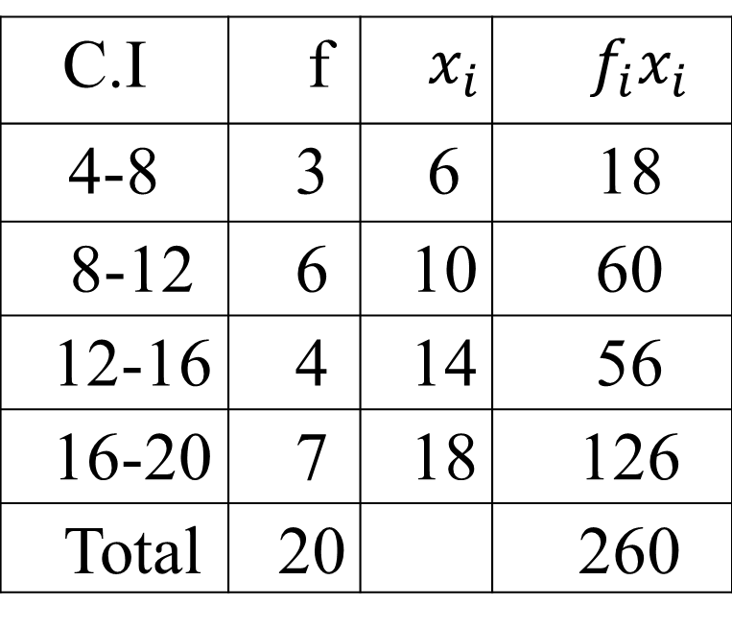
Solution:
C.I | f | $$x_{i}$$ | $$f_{i}x_{i}$$
4-8 | 3 | 6 | 18
8-12 | 6 | 10 | 60
12-16 | 4 | 14 | 56
16-20 | 7 | 18 | 126
Total | 20 |  | 260

Slide 23
Example 3
Calculate mean, variance and standard deviation of the following frequency distribution:
Class interval | Frequency(f):
0-10 | 11
10-20 | 29
20-30 | 18
30-40 | 4
40-50 | 5
50-60 | 3

Slide 24
Solution:
Mean = 21.5
Variance = 161
S. D = 12.7

Slide 25
Recapitulation:
Measures of Dispersion
Range
Mean Deviation
Standard Deviation

Slide 26

Thank you all
25 July 2019

